Slide 1
Lesson 3
CAN Protocol Concepts
Notes:
1) Xin chao moi nguoi, cam on moi nguoi da tham gia vao khoa hoc FuSa
Buoi hom nay la ve phan session 1, overview ve FuSa
2) Truoc em cung gui tai lieu ve FuSa, anh chi em thay the nao.
Tai lieu co de hieu khong ah, cam giac FuSa co de khong ah.
3) Em xin phep buoi nay nhu chia se kien thuc, kinh Nghiem ve FuSa.
Cac anh chi em da co kinh Nghiem lau nam, nen neu co gi khiem khuyet xin cac anh chi em dai xa cho

Slide 2
Contents
Bit Segmentation
Bus Arbitration
Bit Stuffing
CAN CRC Computation

Slide 3
Bit Segmentation - Topic
What is Bit monitoring?
Explain about the 4 bit segments? (What/Why)
Distinguish between Sync (Hard sych) vs Resych (Soft sync) . Why Resync required.

Slide 4
Bus Arbitration - Topic
Present how Bus Arbitration work and its principle. (What, Why, When, How)

Slide 5
Bit Stuffing - Topic
Explain bit stuffing (What, Why, When, How)
Why is bit stuffing not allowed in some CAN fields such as CRC Delimiter, Ack, End of Frame, IFS,…

Slide 6
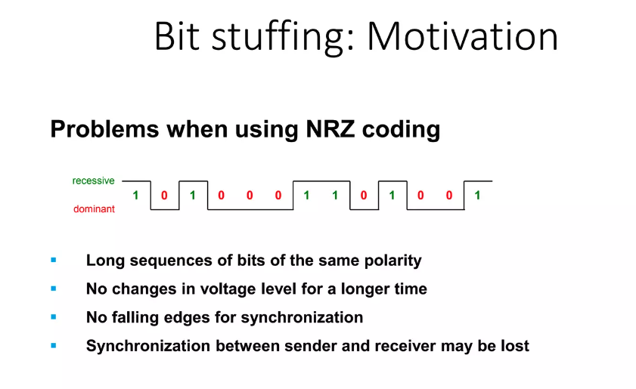
Bit Stuffing - Topic

Slide 7
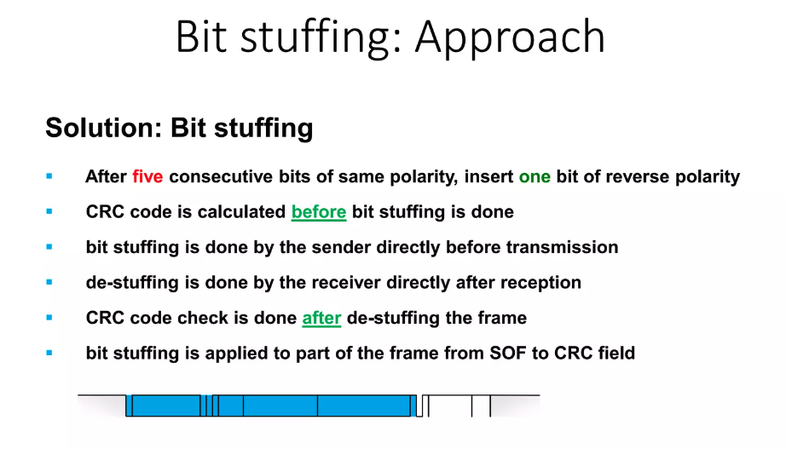
Bit Stuffing - Topic

Slide 8
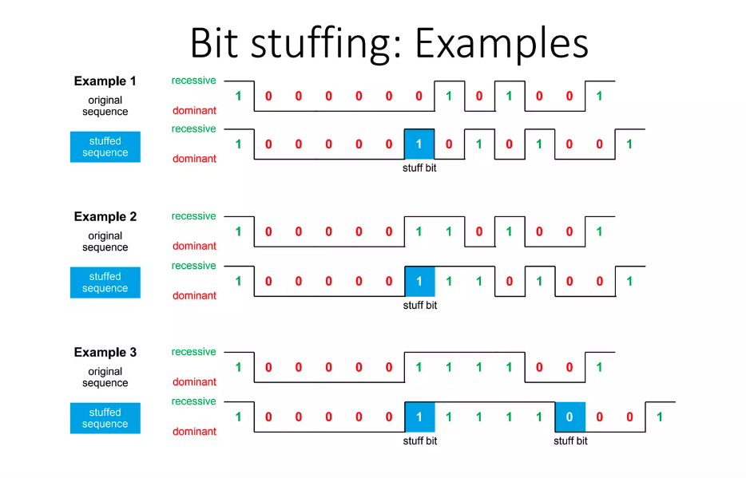
Bit Stuffing - Topic

Slide 9
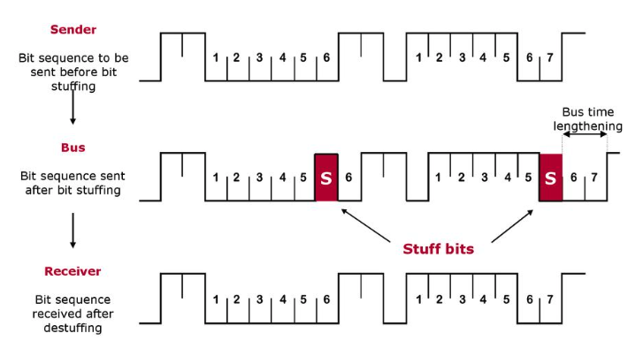
Bit Stuffing - Topic

Slide 10
CAN CRC Computation - Topic
Explain CRC Checksum Computation in CAN (standard CAN Frame)

Slide 11
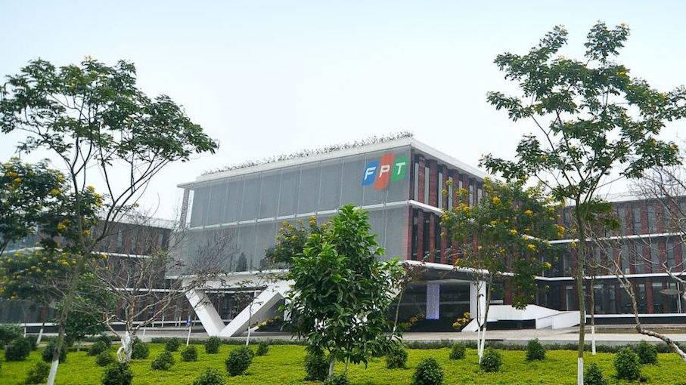


THANK YOU

